Slide 1
Design For Final Project
Web Design and Scripting (JS/JQUERY)
Jao, hagen L.

Slide 2
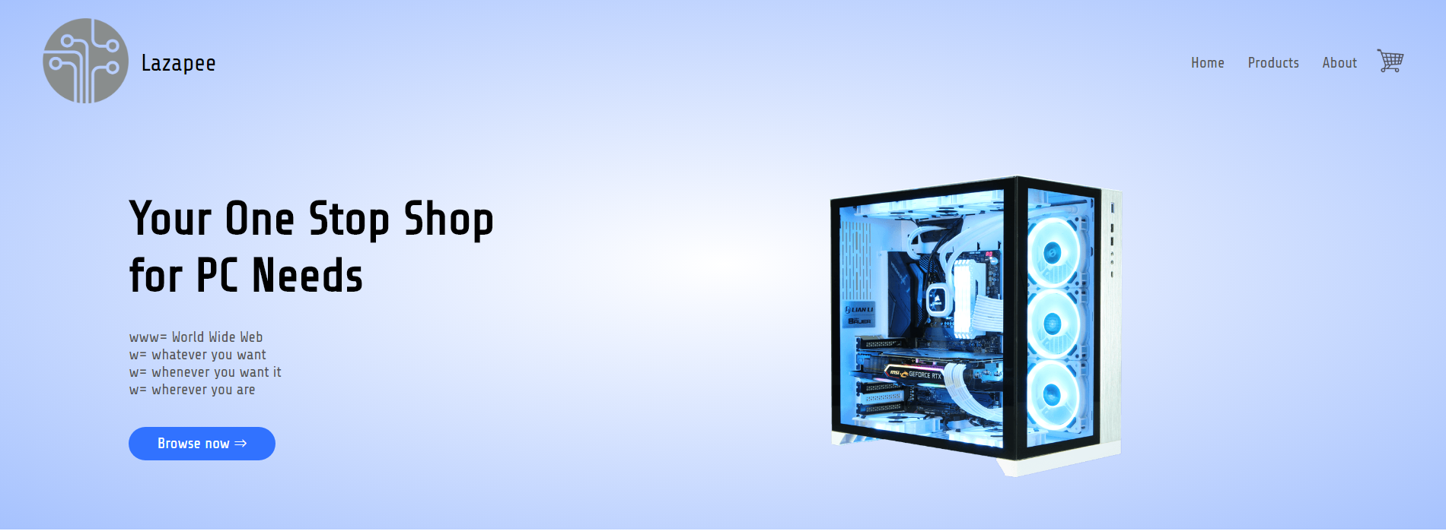
Web App Title: Lazapee

Slide 3
Description:
Lazapee is an e-commerce website that specializes in computer parts and accessories from the entry level, to pc building enthusiasts. The site is also designed to be responsive to users that have smaller screen sizes, such as smartphones.
P.s.
designer for this site does not have any experience prior to the subject which he will pass this to, so the design is rather simple

Slide 4
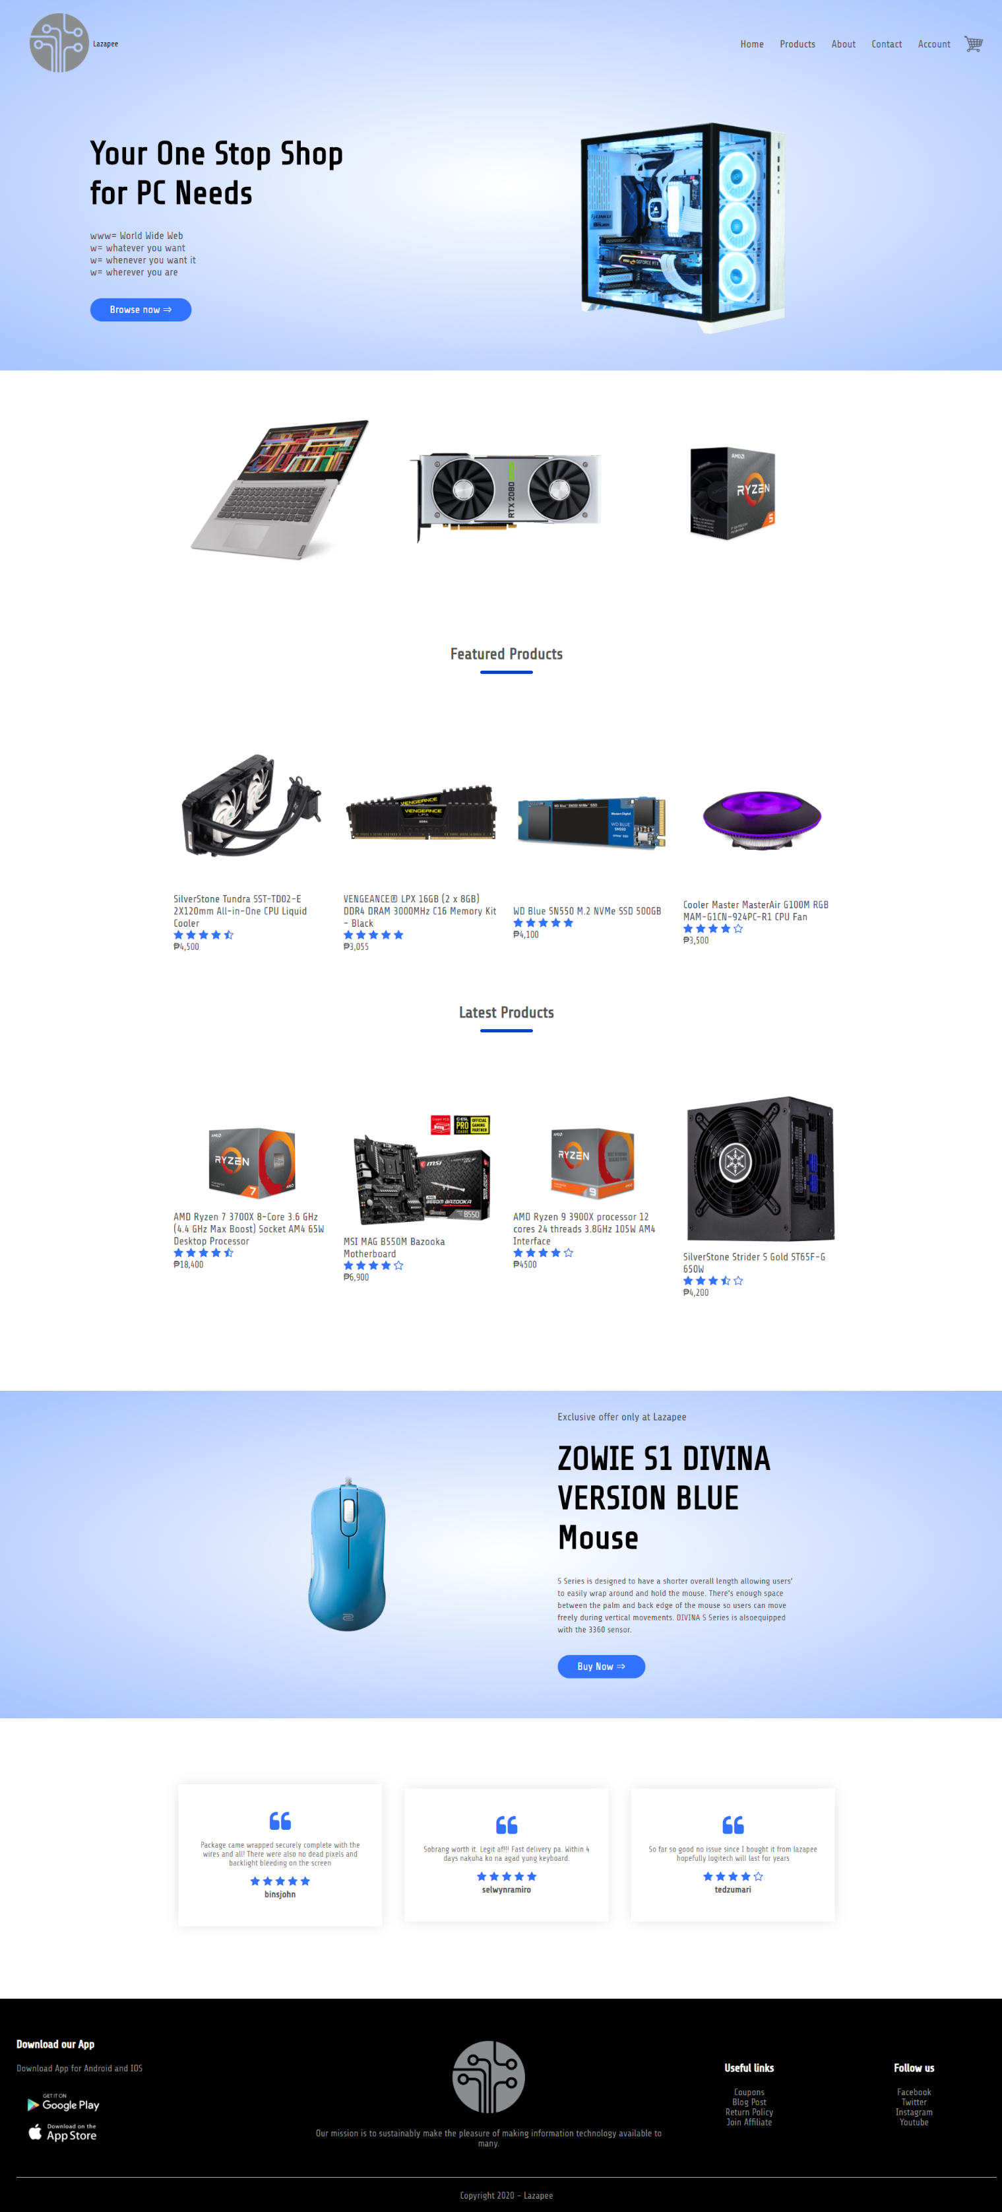
Web design (home page)

Slide 5
Header:
“Products” links to a complete list of items, or All Products Page.
“About” links to the shop’s description.
Shopping cart icon links to Cart Page that shows all items.
“Browse Now” is a button that leads to All Products Page, too

Slide 6
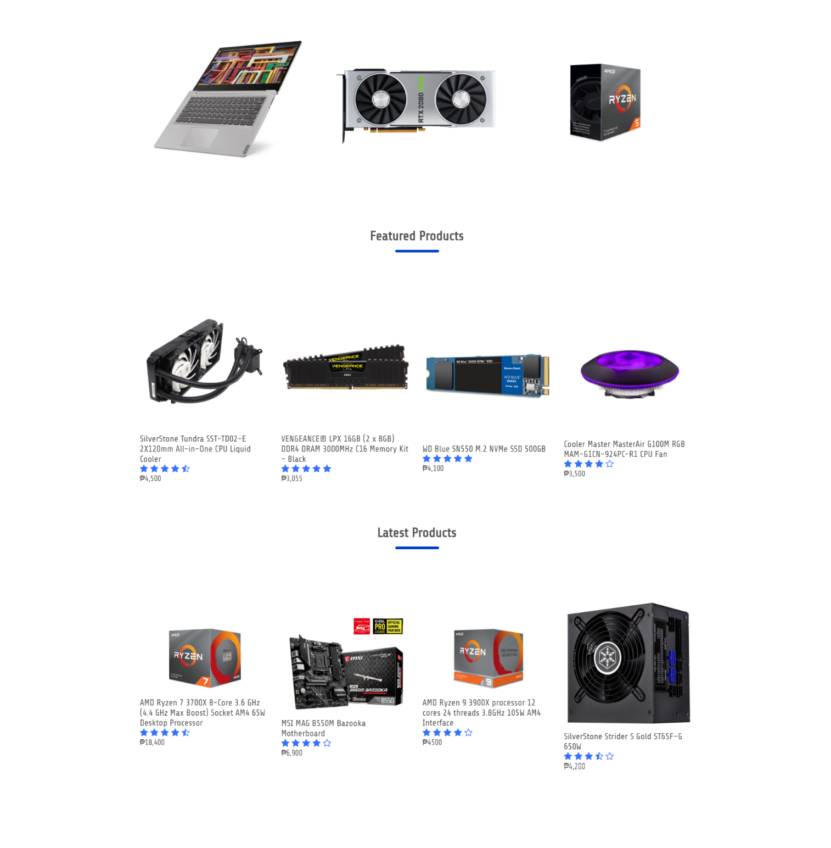
Home Page Featured Category:
Top row is pretty much eye candy (Not clickable)
Row below “Featured Products” and “Latest Products” are clickable and have animation.

Slide 7
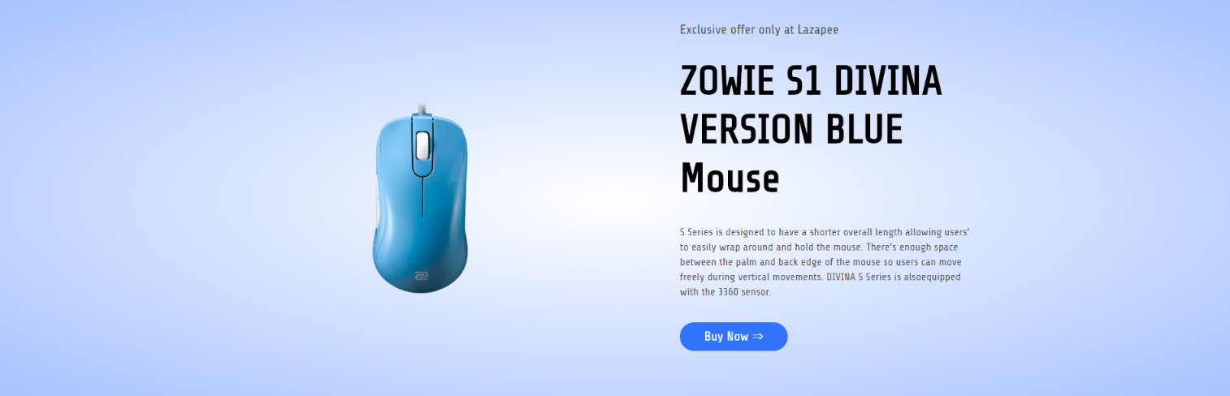
Home Page Exclusive Section:
Simulates exclusive offers found on real e-commerce websites.
“Buy Now” links to the item’s specific Product Details Page.

Slide 8
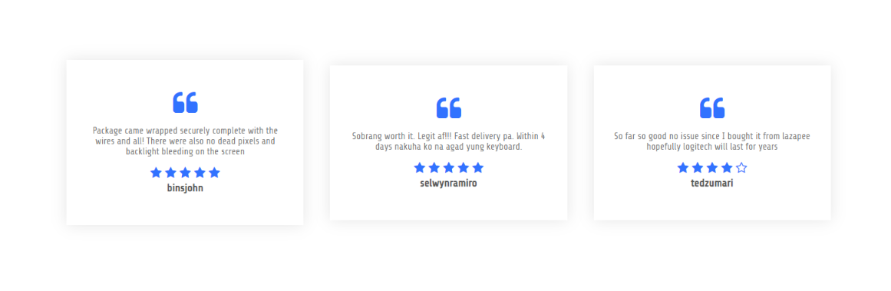
Home Page Testimonial Section:
Same case as Exclusive Section, simulates real e-commerce websites.

Slide 9
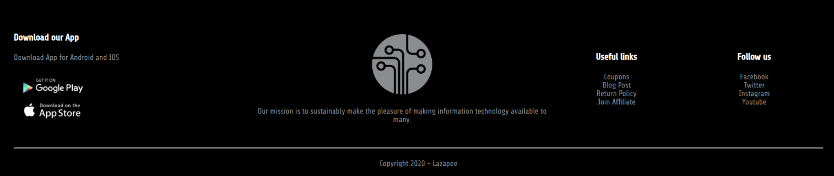
Footer:
Applied lessons from Activity 1 here, “Useful links” and “Follow us” columns are clickable (Hint: The links are surprises, I just want to show that I can link them anywhere I want it to)

Slide 10
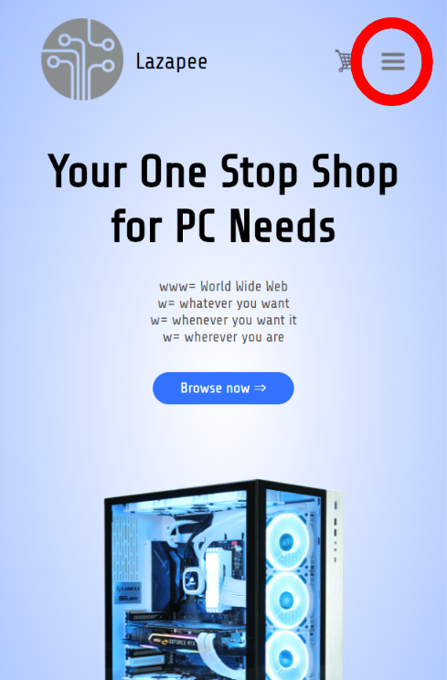
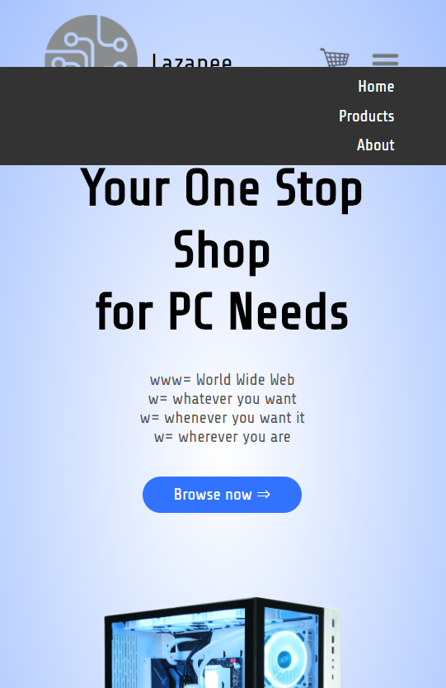
Responsive Site:
The site is also coded for the contents to adapt based on the user screen size. Simulates real-life scenarios where a significant percentage of users browse e-commerce sites with their smartphones.
When the screen is small enough, the site hides the options for the header, it instead shows an “Expand” button, which shows the hidden buttons in a vertically listed form.

Slide 11
User’s manual For Final Project
Web Design and Scripting (JS/JQUERY)

Slide 12
User Manual (page 1)
The site is quite simple, it is rather focused on individual product details page, and their photos’ proper formatting (edited manually to have a 1:1 ratio for uniformity).
Home page (index)
Design Section of this PPT has already discussed the Home Page extensively, so no new info are needed here.
With simplicity in mind, I made the site using only either of the 3 color palettes for my design: Black, White, and Blue (with lighter or darker shades)
Products page
Lists all products and prices on this page. They are clickable and links to their respective Product Details Page. They also have star icons on them to make it look like a real e-commerce site.
Product details page
Individual products have their own pages here.
Features multiple images for each product, with thumbnails that are clickable to show a larger image.
User can also see the item’s quick details here, their price, and Go to Cart button.
At the lower part, there is a section of “Related Products”, which are all clickable together with the “View More” link.

Slide 13
User Manual (page 2)
About Page
Simple page that has a few words about the company’s description and a mock-up picture of websites that have featured Lazapee.
Also has a clickable button that supposedly links to free promos… SUPPOSEDLY.
Cart Page
Has a list of all available items (pictures are clickable), their prices, and the “Quantity” textbox that lets the user input the number they want to order (default in 0).
The “Subtotal” text columns auto-updates based on the product of their item’s price and the number the user inputs in the “Quantity” textbox.
“Total” button adds the numbers of all “Subtotal” texts.
Thank You!

